Slide 1
PREDICTIVE ANALYSIS OF SMARTPHONE SELLING PRICES USING LINEAR REGRESSION

Slide 2
INTRODUCTION
The objective of our analysis is to develop a predictive model to estimate smartphone selling prices.
Features such as brand, color, memory, storage and rating were utilized in the analysis.
Understanding factors that influence smartphone prices is crucial for consumers and businesses.
For consumers, they can benefit from this information by enabling them to make more informed purchasing decisions.
For businesses, understanding these factors is crucial for pricing strategies and to maximize profits.
This presentation will cover the methods we used in data collection and preprocessing, feature engineering, model selection, training and evaluation, and discuss the results obtained.

Slide 3
Data Collection and Preprocessing
The dataset used was obtained from Kaggle. It contains information about various attributes of smartphones including brands, colors, memory, storage, ratings, original prices, discounts and selling prices.
Before analysis, we conducted thorough preprocessing which included:
Identifying and addressing missing values using appropriate methods such as imputation and removal.
Cleaning inconsistent and data containing errors.
Scaling of numerical features.
Identifying and removing outliers.
Categorical variables such as brands and colors were encoded using one-hot encoding technique. This converted them into binary format.

Slide 4
Data Collection and Preprocessing
The dataset contained the following columns:
Brands – Describes the various brands of smartphones in the dataset e.g., Samsung, Apple, HTC, Infinix, Google pixel.
Colors – Describes the colors of the smart phones e.g., black, gold.
Memory – The storage capacity of smartphones, measured in gigabytes (GB) or megabytes (MB).
Storage – Describes the internal storage capacity of smartphones, measured in Gigabytes (GB) or Megabytes (MB).
Rating – User rating scores assigned to the smart phones, reflecting user satisfaction or performance.
Selling price – Price at which smart phones are sold to the customers.
Original price – Original or list price of the smartphone before any discounts or promotions.
Mobile – Indicates whether the device is a mobile phone.
Discount – Refers to the discount applied to the original price to calculate the selling price.
Discount percentage – Percentage discount applied to the original price to calculate the selling price.

Slide 5
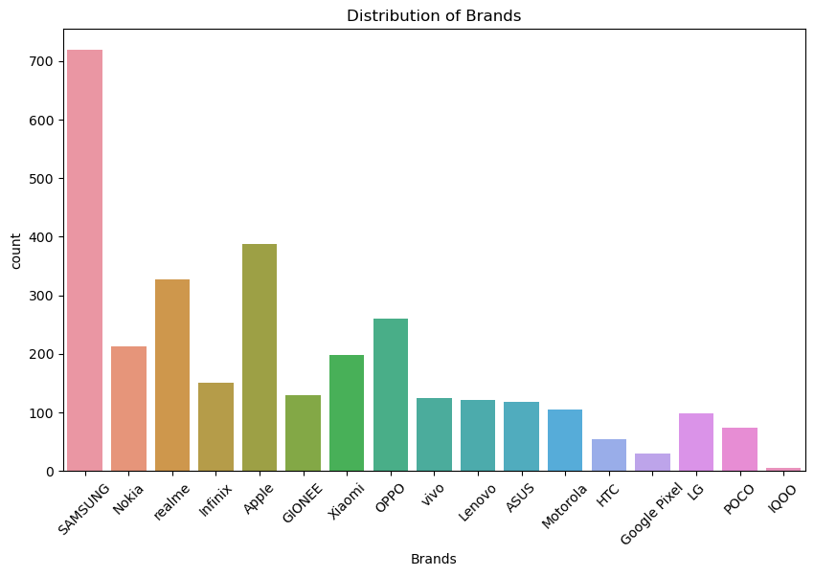
Data Collection and Preprocessing
The following is the distribution of the various brands of smartphones from the dataset.
Samsung brand has the biggest count, followed by Apple, Realme, OPPO and Nokia.
HTC, Google Pixel and IQOO brands had the lowest count of the smartphones in the dataset.

Slide 6
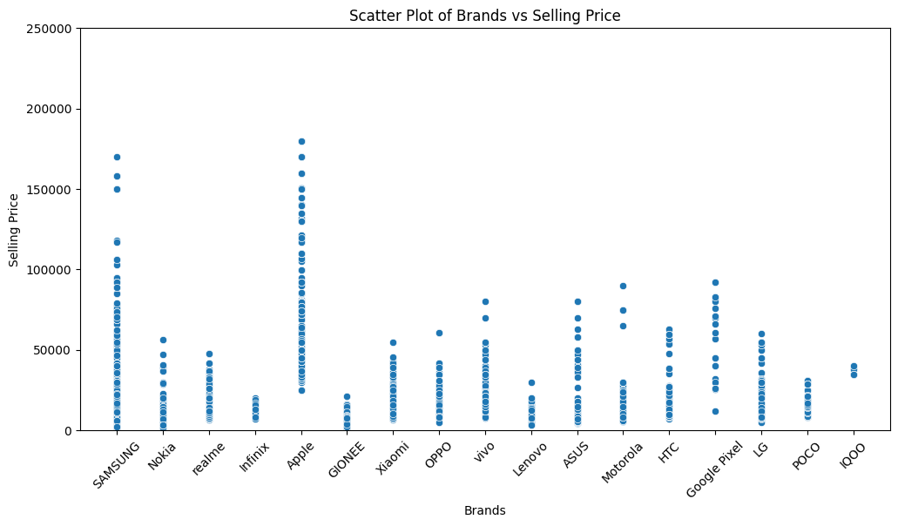
Data Collection and Preprocessing
Brands VS Selling Price
Apple and Samsung phone brands had the highest selling prices.
They were followed by Google pixel, Motorola, Vivo and ASUS.
GIONEE and infinix had the lowest selling price.

Slide 7
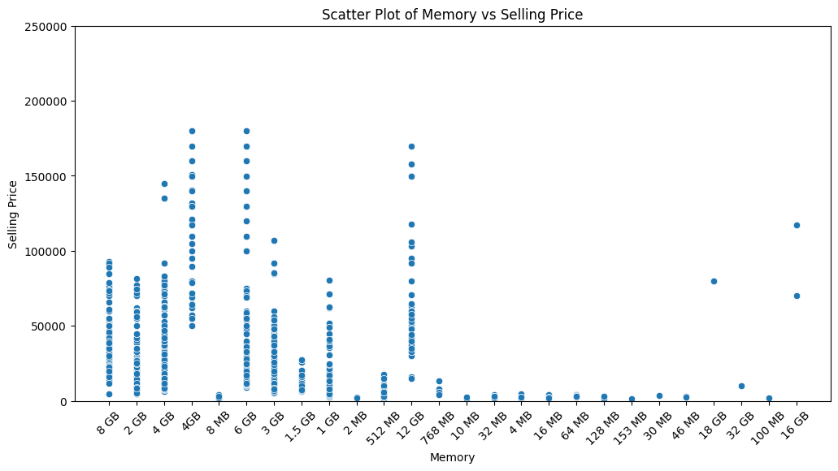
Data Collection and Preprocessing
Memory VS Selling Price
Smart phones with memories of 4GB, 6GB and 12GB had the highest selling prices.
They were followed by those with 8GB, 3GB, 2GB and 1GB.
Those whose memories were in megabytes (MBS) had the lowest selling prices.

Slide 8
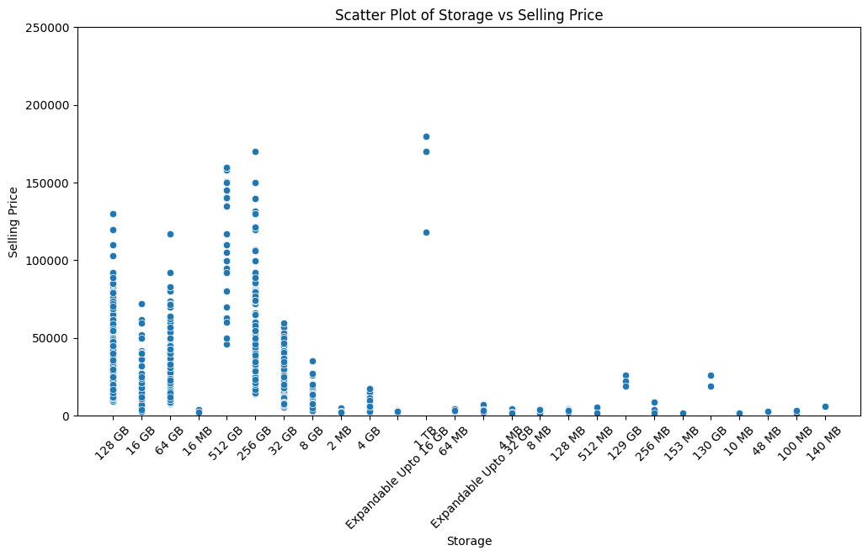
Data Collection and Preprocessing
Storage VS Selling Price
Smart phones with storage of 1TB, 256GB, 512GB and 128GB had the highest selling prices.
They were followed by those with 64GB, 32GB, 16GB and 8GB.
Those whose memories were in megabytes (MBS) had the lowest selling prices.
This proves that the higher the storage, the higher the selling prices.

Slide 9
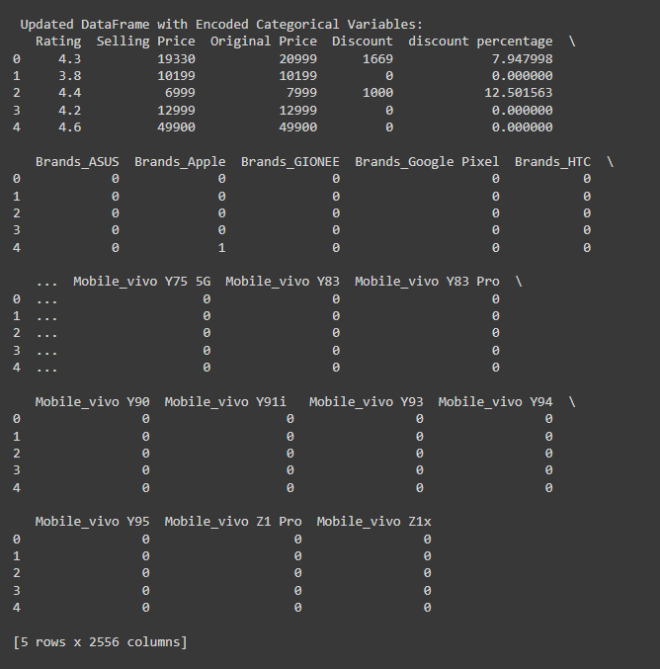
Feature Engineering
This involves transforming raw data into features suitable for machine learning algorithms.
We utilized the following feature engineering techniques:
Creation of dummy variables –These were created using one-hot encoding for color and brands columns. This was important to help us include categorical data in our linear regression model.
Scaling numerical features – We used scaling techniques such as normalization and standardization to ensure all numerical features were comparable. This helps to prevent features with higher magnitudes from dominating the model when training.

Slide 10
Model Selection
For our model, we chose linear regression. Linear regression is a simple regression algorithm that models the relationship between a dependent and one or more independent variables.
Linear regression assumes a linear relationship between the independent variables and dependent variables.
Given the nature of our dataset and our objective of predicting smart phones selling prices, Linear regression was best for our analysis.
Linear regression provides insights into the importance of different features in determining smartphone prices, such information is crucial for stakeholders in the industry.

Slide 11
Model Selection
Linear regression will enable us to examine the following about the dataset:
Relationships between variables - Linear regression enables us to inspect whether the independent variables (brands, colors, memory, storage, rating) are correlated with the dependent variable (selling price). For instance, if the coefficient of a given feature e.g., rating is positive, it shows that there is a positive relationship between the increase of that feature and the target variable (Mali, 2024).
Measuring the strength of association - The R-squared indicator assists us in determining linear regression ‘s strength of association among the independent and dependent variables (Marcelino, 2024).
Identification of Outliers and meaningful observations - Correlation and linear regression analysis can be used in the search of outliers and influential observations in the dataset (Mali, 2024).
Prediction - The most important role of linear regression is prediction. Through the coefficients acquired from regression, one could set up a predictive model for the dependent variable in terms of the independent variables (Marcelino, 2022).

Slide 12
Model Selection
Assumptions about linear regression:
Linear relationship – The relationship between the dependent variable and feature variables should be linear. This linearity can be tested using scatter plots.
Little or no multi-collinearity – It is assumed that feature variables (independent variables) are not independent of each other (Geeks for Geeks, 2023).
Little or no autocorrelation – It I also assumed that there is little or no autocorrelation, which occurs when the residual errors are not independent of each other.
No outliers – We assume that there are no outliers in the data. Outliers are data points far away from the rest of the data and can affect the results of the analysis (Geeks for Geeks, 2023).
Homoscedasticity – It describes a situation where the error term (disturbance in relationship between dependent and independent variables) is the same across all values of the independent variables (Geeks for Geeks, 2023).

Slide 13
Training and Evaluation
The dataset was divided into two sets: a training set and a testing set.
The training set comprised of the majority of the data (75%) and was used to train the linear regression model.
The testing set comprised of the remaining portion (25%) and was used to evaluate the model’s performance.
During training, the model learned the coefficients of the linear equation that best fits the independent variables (other features) and dependent variable(selling price).
The model was then evaluated using two key metrics: Mean squared error(MSE) and R-squared.
MSE measures the average square difference between the predicted and actual values of the target variable(selling price) with a lower value representing a better model performance.
R-squared represents the proportion of the variance in the target variable (selling price), that is explained by independent variables. ! Indicates a perfect fit.

Slide 14
Results
Mean Squared Error (MSE) – The MSE for the model was 1.2822768629458008e-20. This is extremely low, indicating a very close fit between the actual and predicted selling prices. This suggests that the model performs well on the test data.
R-squared - The R-squared value of 1.0 indicates that the model explains 100% of the variance in the target variable (selling price). This is an excellent performance of the model.
Coefficients:
Rating: 5.142820e-11
Original Price: 1.000000e+00
Discount: -1.000000e+00
Discount Percentage: 1.403872e-12
The coefficient for the “original price” is 1.0, which suggests that for every unit increase in the original price, the predicted selling price increases by the same amount. This signifies a direct linear relationship between the original and selling price. The coefficient for discount is -1.0, which suggests that for every unit increase in the discount, the predicted selling price decreases by that amount

Slide 15
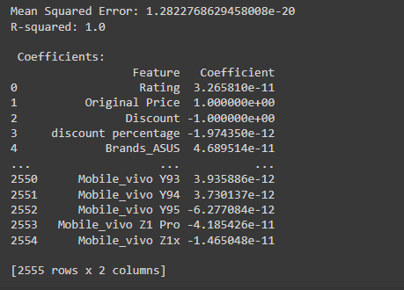
Results

Slide 16
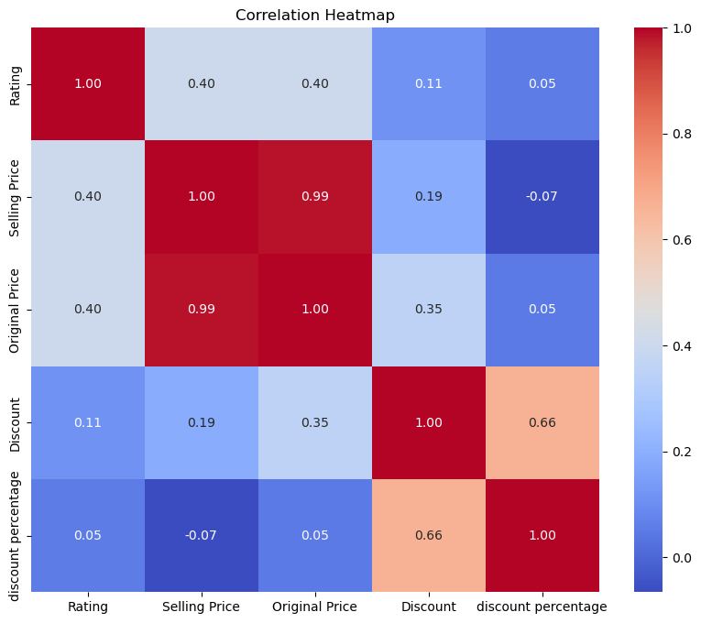
Results
The following heatmap shows the correlation of the data columns:
The correlation matrix highlights the correlation coefficients between various variables. Each column and row highlight a different variable, with the intersection carrying the correlation coefficient among the variables represented by that particular row and column (Bock, 2024).
There is a high correlation between the selling price and the original prices of the phones. This indicates that a very small discount was offered.
This can be further proven by the low correlation between the selling price and discount (0.19) and the discount percentage (-0.07).

Slide 17
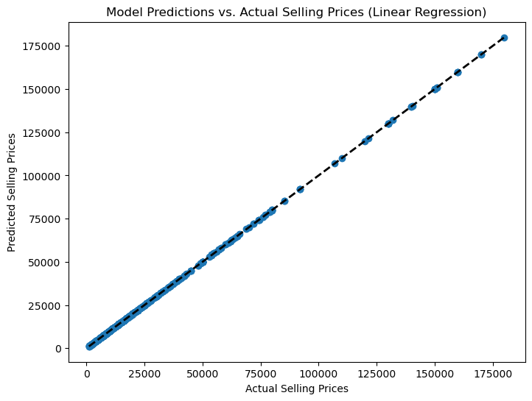
Visualization of the model prediction

Slide 18
Visualization of the model prediction
The scatter plot above depicts the predicted versus the actual selling prices. It provides a clear visualization of the model’s performance, showing its high accuracy.
The predicted selling prices are directly proportional to the actual prices and follow a linear path.
This indicates that the model was highly accurate in predicting the prices of smartphones based on the independent features such as brand, colors, memory, storage and ratings.

Slide 19
Conclusions
The Linear regression model exhibited highly accurate performance in predicting the selling prices of smartphones.
This is evident from the negligible Mean Square Error and the perfect R-squared value.
The close alignment of the predicted and actual selling price on the scatter plot further emphasizes the accuracy and reliability of the model’s prediction.
The findings provide valuable insights into factors influencing smartphone prices and the effectiveness of the linear regression predictive model.
These insights can inform pricing strategies, marketing campaigns and product development initiatives in the smart phone industry which can enable stakeholders to make data-driven decisions to maximize profits and stay ahead of the competition.

Slide 20
Conclusions
Applications for stakeholders:
Pricing strategies – Accurate prediction of smartphones selling prices can help manufacturers and retailers optimize pricing strategies to remain competitive in the market.
Market positioning – By understanding factors influencing smartphone prices, stakeholders can position their products effectively within the market, targeting specific consumer segments based on pricing preferences.
Consumer insights – Insights gained from the analysis can provide valuable information about consumers and their preferences, which helps companies to customize their products to meet customer demands effectively.

Slide 21
References
Bock, T. (2024, January 2). What is a Correlation Matrix? - Displayr. Displayr. https://www.displayr.com/what-is-a-correlation-matrix/
GfG. (2023, December 7). Linear Regression (Python Implementation). GeeksforGeeks. https://www.geeksforgeeks.org/linear-regression-python-implementation/
Mali, K. (2024, January 23). Everything you need to Know about Linear Regression! Analytics Vidhya. https://www.analyticsvidhya.com/blog/2021/10/everything-you-need-to-know-about-linear-regression/
Marcelino. (2022, April 30). Comprehensive data exploration with Python. Kaggle. https://www.kaggle.com/code/pmarcelino/comprehensive-data-exploration-with-python

